Slide 1
New York times and baseball
extra

Slide 2
Goal
How has topic coverage varied over last 7 years
Steps
Establish base clusters across all years
Evaluate each year’s articles by cluster weights

Slide 3
NYTimes 2011- 2017
2011 – 36,103
2012 – 36,057
2013 – 34,795
2014 – 40,790
2015 – 42,086
2016 – 42,071
2017 – 36,117
Total – 268,019
105k Subset
(15,000 from each year)
50 Reduced Features
KMEANS
18 Clusters
LSI

Slide 4
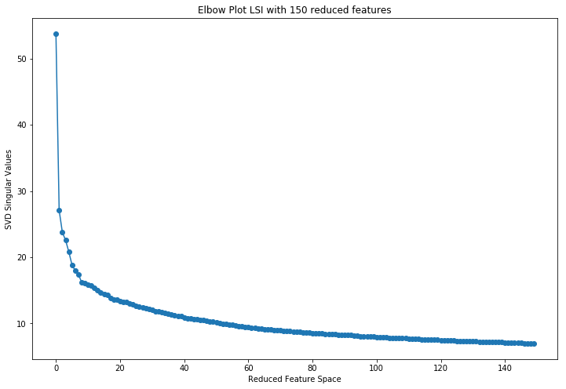

Slide 5
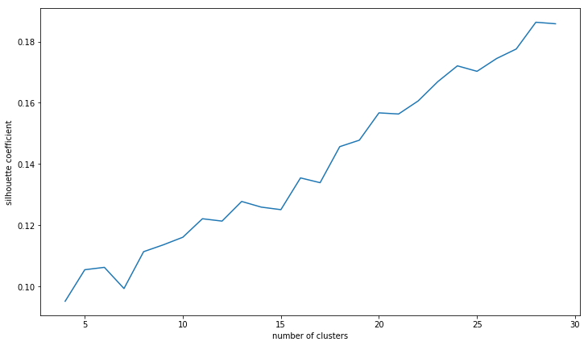


Slide 6
New York City students scored slightly lower on federal math tests this year compared with two years ago, according to results released on Wednesday, even as test scores of their counterparts in other big cities inched upward.
Harvard and Ohio State are not going to disappear any time soon. But a host of new online enterprises are making earning a college degree cheaper, faster and flexible enough to take work experience into account.
The 10th grader at Public School 12 in the Bronx, a school for students with behavioral issues and special needs, had a reputation among his classmates as a bully.

Slide 7
HONG KONG - Japan on Wednesday reported a decline in exports for March, providing new details of the impact the natural and nuclear disasters have had on its economy, particularly among manufacturers.
BERLIN — As Europe struggles to reverse a plunge in financial confidence, the world waits for Germany’s chancellor, Angela Merkel, to make a fundamental choice.
Traders have been overwhelmed by the prospects of a global economic slowdown, a euro zone debt problem and other issues.

Slide 8
'0.307*"trump" - 0.224*"police" + 0.219*"mr" - 0.179*"said" + 0.145*"republican"
'-0.252*"graduated" - 0.205*"bride" - 0.191*"university" -0.175*"law" -0.158*"groom"
'0.301*"police" + 0.193*"said" - 0.192*"trump" - 0.179*"china" - 0.140*"graduated" - 0.138*"iran"
0.175*"police" -0.148*"republicans" -0.139*"health" -0.131*"republican" -0.117*"tax"

Slide 9
iran: 16
Police: 13
Trump: 16
Obama: 15
Knicks: 9 times
Yankees 10 times

Slide 10
Latent dirichlet Allocation
20 Topics
LDA
105k
Count Vectorize

Slide 11

Score: 0.9352
ADEN, Yemen (Reuters) — The Yemeni Army battled militants linked to Al Qaeda in the southern town of Zinjibar on Saturday, recapturing important positions in the rebel-held city and killing at least 62 Islamist fighters, a military official said…
Score: 0.9317
SANA, Yemen (AP) — The death toll from a suicide bombing in southern Yemen rose to 45 on Sunday, officials said, in the latest attack against militias allied with the army…

Slide 12

Score: 0.96397
Honeywell International said on Friday that its profit rose 10 percent in the third quarter as new products and emerging market growth offset weakness in Europe.
Score: 0.95374
Tiffany & Company reported Thursday that its third-quarter net income fell about 30 percent, citing a higher-than-expected tax rate, economic weakness and high precious metal and diamond costs.

Slide 13

Dr. Marisa Rory Mendel, the daughter of Ilene S. Mendel and Dr. Herbert E. Mendel of Fayetteville, N.Y., was married Saturday evening in Syracuse to Joshua Michael Abraham, a son of Harriet Sostman Abraham and Dr. Jerrold L. Abraham, also of Fayetteville.
Dr. Alisse Katherine Hauspurg and Dr. Adam James Janicki were married Saturday at Saltwater Farm Vineyard in Stonington, Conn.
Dr. Alexis Jenks Roettinger and Christopher Matthew Markowski were married Saturday evening at St. Columba’s Chapel in Middletown, R.I.

Slide 14
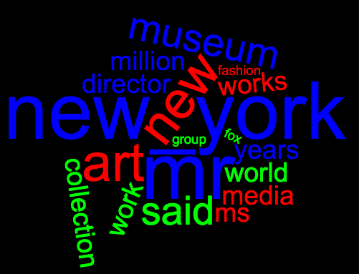
Michael Baer joined Starcom USA, Chicago, in a new post, executive vice president and managing director, overseeing the Hallmark, Lego, Luxottica Group and Walgreens accounts.
Black Bag Advertising, San Francisco, was acquired by Essence Digital. Financial terms were not disclosed. The deal is part of expansion plans in the United States for Essence Digital, which is based in London and has an office in New York.
Hanna Adams joined PJA Advertising and Marketing as an account supervisor. She had been an account supervisor at Hill Holliday, Boston, part of the Interpublic Group of Companies.

Slide 15
Topic Fitting By Year
0: 0.1396
2: 0.1812
3: 0.0252
4: 0.0306
5: 0.0160
7: 0.2852
10: 0.0121
13: 0.0309
14: 0.0699
16: 0.1601
20 Topics
Pre-trained
LDA
2011 Articles
Pre-fitted
Count Vectorizer
0: 0.2364
2: 0.0812
3: 0.0252
4: 0.0306
5: 0.0160
7: 0.2852
10: 0.0121
13: 0.0309
14: 0.0699
16: 0.1601
0: 0.1159
2: 0.1021
3: 0.0252
4: 0.0306
5: 0.0160
7: 0.2852
10: 0.0121
13: 0.0309
14: 0.0699
16: 0.1601

Slide 16
Year | Middle East Violence | Op-Ed (personal stories) | Energy | Telephone polling results | Finance | Bridge Card Game | Baseball | Culinary | Marriages
2011 | 0.0663 | 0.1164 | 0.0446 | 0.0742 | 0.0752 | 0.0409 | 0.0326 | 0.0199 | 0.0533
2012 | 0.0600 | 0.1156 | 0.0401 | 0.0702 | 0.0684 | 0.0422 | 0.0321 | 0.0203 | 0.0574
2013 | 0.0601 | 0.1141 | 0.0432 | 0.0748 | 0.0657 | 0.0405 | 0.0329 | 0.0203 | 0.0510
2014 | 0.0647 | 0.1144 | 0.0421 | 0.0710 | 0.0670 | 0.0472 | 0.0272 | 0.0191 | 0.0488
2015 | 0.0628 | 0.1196 | 0.0386 | 0.0627 | 0.0745 | 0.0380 | 0.0268 | 0.0238 | 0.0455

